Slide 1
PROJECT TITLE :
Mobile Phone Repair Management System
Student Name: Osama Aidrous AHMED ALI
Student ID: 28264/2024
Course: DPR400210 – Database Programming with Oracle Database
LECTURER: Mr. MANIRAGUHA Eric

Slide 2
Problem Definition
Many mobile phone repair shops still rely on manual methods to manage customer information, repair requests, spare parts, and payments. This often leads to lost records, delays in repair services, inventory management problems, and difficulty tracking completed and pending repairs.
Context of Use:
This system is designed for mobile phone repair shops. It helps staff manage customer information, register repair requests, assign technicians, monitor repair progress, manage spare parts, and process payments using an Oracle Database system.

Slide 3
Target Users
Shop Administrator, Reception Staff ,Technicians , Store Manager.
Project Objectives
1. Store customer and device information.
2. Manage repair requests efficiently.
3. Track repair status.
4. Manage spare parts inventory.
5. Record customer payments.
6. Generate accurate reports.
Expected Benefits
1. Reduce manual errors.
2. Improve repair tracking.
3. Increase service efficiency.
4. Better inventory management.
5. Faster access to customer and repair records.

Slide 4
Business process model (bpmn)
Customer
Submit Repair Request
Reception Staff
Register Customer & Device
Administrator
Assign Technician
Technician
Inspect Device
Repair Device
Update Repair Status
Reception Staff
Receive Payment
Return Device to Customer

Slide 5
Business process explanation
The repair process begins when a customer brings a mobile phone to the repair shop and submits a repair request. The reception staff registers the customer's information and the device details in the system. The administrator then assigns the repair task to a technician. The technician inspects the device, performs the required repair, and updates the repair status. If spare parts are needed, they are recorded in the system. After the repair is completed, the reception staff processes the payment and returns the repaired device to the customer. All transactions are securely stored in the Oracle Database for tracking, reporting, and auditing purposes.

Slide 6
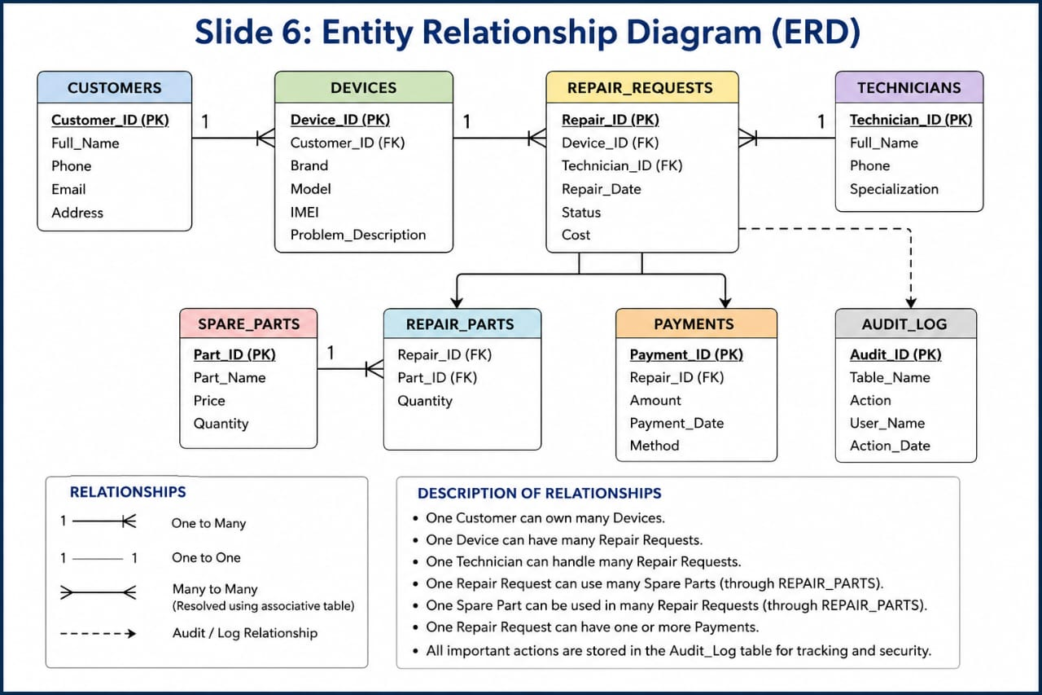

Slide 7
Database tables & relationships
Database Tables
Customers
Devices
Technicians
Repair Requests
Spare Parts
Repair Parts
Payments
Audit Log
Relationships
One Customer can own many Devices.
One Device can have many Repair Requests.
One Technician can handle many Repair Requests.
One Repair Request can use many Spare Parts.
One Repair Request can have one or more Payments.
Normalization
The database is normalized up to the Third Normal Form (3NF) to eliminate data redundancy and improve data integrity.

Slide 8
pl\sql implementation
Procedures
Add Repair Request
Assign Technician
Process Payment
Functions
Calculate Repair Cost
Check Device Repair Status
Packages
Repair Management Package
Payment Management Package
Cursors
Display Pending Repair Requests
Display Completed Repairs
Exception Handling
Invalid Repair ID
Payment Validation
Duplicate Device Registration
Transaction Control
COMMIT 2. ROLLBACK

Slide 9
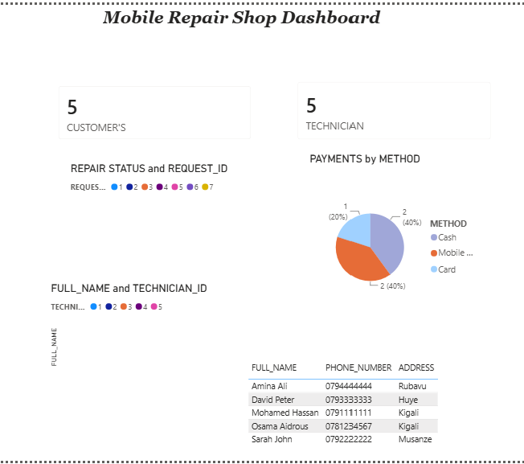
Advanced Database Programming & Innovation
Triggers
Automatically update repair status.
Record INSERT, UPDATE, and DELETE operations.
Restrict database modifications during weekdays and public holidays.
Audit & Security
Track user activities.
Maintain audit logs.
Control user access and privileges.
Innovation
Power BI Dashboard.
Total Repair Requests Report.
Monthly Revenue Report.
Most Repaired Phone Brands Report.
Technician Performance Report.

Slide 10
Future Improvements
Develop a mobile application for customers.
Send SMS or email notifications about repair status.
Integrate online payment services.
Enhance analytics with Power BI dashboards.
Add AI-based repair prediction features.
Conclusion
The Mobile Phone Repair Management System provides an efficient and secure solution for managing repair requests, customer information, technicians, spare parts, and payments. It improves operational efficiency, ensures data accuracy, and supports better decision-making using Oracle Database technologies.

